Slide 1

Department of Computer Science and Engineering CSB4332 – DESIGN PROJECT WITH IOT CONTACTLESS DOORBELL SYSTEM
R E Dharshan 21113049
S S Harish Jayaram 21113050
P A Abirajah 21113050
SUPERVISORS
Dr.K.Vijayalakshmi, Professor

Slide 2
Introduction
Welcome to our groundbreaking project: The Contactless Doorbell System. In today's fast-paced world, security and convenience are non-negotiable. Our system is a fusion of innovation and practicality, utilizing advanced technologies to redefine home security. By combining precise human presence detection, secure data storage, and user-friendly interfaces, we've crafted a doorbell solution that not only guarantees safety but also respects your privacy.

Slide 3
Goals and Motivation
Goals:
Minimize physical contact for safety and hygiene.
Log visitor and delivery data for security and accountability.
Prioritize user privacy by enabling complete ownership and control over captured data
Optimize system response time to provide real-time notifications and user interaction

Slide 4
Goals and Motivation
Motivation:
The motivation behind this project Address the growing need for advanced security solutions in both residential and commercial environments.
Streamline the visitor identification process, allowing users to make informed decisions and control access remotely through a smartphone app.

Slide 5
Literature review/Existing Systems
S.No | Title of the paper/System | Authors | Publication (Name of the Journal/Conference proceedings with Year) | Algorithm/Methodology adopted | Limitations
1. | Machine Learning With The Pong Game | Doina ,Logofătu | 21st International Conference on Computational Science and Applications(ICCSA),2021 | Q-learning is reinforcement learning algorithm where an agent learns to make decisions. Algorithm:Q-Learning | Accuracy:44.6% The Q-values requires more data
2. | Machine Vision-Based Ping Pong Ball Rotation Trajectory | Yilei, Wang & Ling, Wang | Journal of Computational Intelligence and Neuroscience,2022 | CNN also known as convnets used for image processing and object detection Convolutional neural network(CNN) | Accuracy:40.6% clarity of the captured video is not high enough, and the noise is high enough to make it indistinguishable
S.No | Title of the paper/System | Authors | Publication (Name of the Journal/Conference proceedings with Year) | Algorithm/Methodology adopted | Limitations
1. | Contactless IoT Doorbell | Ms.Shefali Raina, Vishwesh Pratap Singh, Md.Sajid Akhtar, Sidhant Ranjan Rishabh& Ajab Singh | 22nd Journal of Emerging Technologies and Innovative Research(JETIR), 2022 | Ultrasonic sensor detects infrared changes Using of Arduino UNO to send info to mobile | Costlier than esp32 Latency of information
2. | Doorbell System in Home Using IoT | B.Baron Sam1 , K. Purna Chander , K. Vinay & , A.Pio sajin | International Conference on Frontiers in Materials and Smart System Technologies,2021 | Utilizes protocols like MQTT or HTTP for efficient communication. Fine-tune sensor parameters to reduce negatives and optimize | High Power Consumption Old Usage of sensor

Slide 6
Literature review/Existing Systems
S.No | Title of the paper/System | Authors | Publication (Name of the Journal/Conference proceedings with Year) | Algorithm/Methodology adopted | Limitations
3. | Pong Game using AI | Akash ,R., Ruchika ,P .,& Ashish ,P.K | International Journal of Scientific and Research Publications,2022 | Q-learning is reinforcement learning algorithm where an agent learns to make decisions. The algorithm takes on both paddles using ai or bot Algorithm:Q-Learning | Lack of adaptability in different environment Accuracy:64.7 %
4. | Design of Game Pong using VHDL | Sudhanshu M.M., Nakul.N., | International Journal of Engineering Research & Technology (IJERT),2022 | Control the paddles is done without clicking repeatedly Algorithm:State Machine Algorithm | It will work only in the platform of windows Accuracy-50.4
S.No | Title of the paper/System | Authors | Publication (Name of the Journal/Conference proceedings with Year) | Algorithm/Methodology adopted | Limitations
3. | IoT & AI Based Smart Doorbell System | Prof. S.B. Sahu, Arati F. Paswan &, Kavita K. Tandi | International Journal Of Creative Research Thoughts,2021 | Employs deep learning models (e.g., CNN) to analyze captured images. Set up cloud services (e.g., AWS, Azure) for data storage and processing. | Lack of combability. Security Risks
4. | A STUDY ON IOT SMART DOORBELLS | C.K Gomathy, & Devulapalli | International Journal Of Creative Research Thoughts,2021 | Classifies visitors, distinguishes between humans, animals, and objects. Validate AI model accuracy, system responsiveness, and image analysis effectiveness. | Bias in AI Models: AI models may inherit biases from training data, affecting visitor classification accuracy.

Slide 7
Problem Definition
Create a contactless doorbell system that enhances security and convenience in residential and commercial settings.
Enable real-time remote monitoring of the doorstep through a smartphone app.
Capture images when human presence is detected and securely store them on a local cloud server.
Design an intuitive user interface within the Blynk app for viewing images and making informed decisions.
Prioritize privacy and data security by storing images locally and implementing robust security measures.
Inspire individuals and companies to develop IoT solutions with a focus on user privacy and data control.

Slide 8
Objective
Enable real-time remote monitoring of the doorstep through a smartphone app.
Capture images when human presence is detected and securely store them on a local server.
Design an intuitive user interface within the Blynk app for viewing images and making informed decisions.
Prioritize privacy and data security by storing images locally and implementing robust security measures.

Slide 9
Proposed System/Work
In this project, we are going to make contactless doorbell system.
Designing the hardware setup using the ESP32-CAM device, including integrating sensors for human presence detection and a buzzer for alerts.
Creating the Blynk app interface that enables remote monitoring, image viewing, and remote door unlock control.
Developing the local cloud server infrastructure on a Windows platform to securely store and manage captured images.
Ensuring the system's reliability, security, and user-friendliness through thorough testing and user feedback.
Demonstrating the system's effectiveness through scenarios involving human presence detection, image capture, remote monitoring, and remote door unlock.

Slide 10

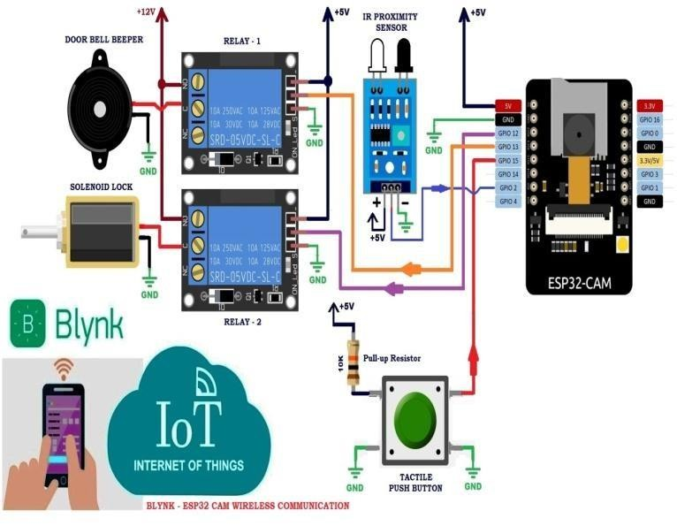
ARCHITECHTURE DIAGRAM:

Slide 11
Modules Description
Human Presence detection:
Utilizes an infrared sensor and ESP32-CAM for accurate detection of human presence
at the door.
Image Capturing and Processing:
Captures images of visitors and processes them for further analysis and storage.
Data Transmission:
Implements protocols like MQTT or HTTP for efficient communication between the
system components.
Remote Monitoring:
Integrates the Blynk app for real-time remote monitoring and control of the
doorbell system.
Local Cloud Storage:
Utilizes a Windows-based local server for secure storage of captured images,
ensuring data privacy and integrity.

Slide 12
Design Requirements
1.Accurate Human Presence Detection
2.Real-Time Alerts and Image Capture
3.Secure Data Transmission
4.User Authentication and Access Control
5.Intuitive User Interface
6.Compatibility and Interoperability
7.Local Server Setup
8.Energy Efficiency
9.Remote Door Unlock Functionality
10.Responsive Real-Time Communication
11.User Privacy
12.Scalability and Performance

Slide 13
Design Requirements
Considerations for hardware, software, connectivity,
security, and user experience:
1. Hardware:
Sensor Selection
Camera Quality
2. Software:
App Interface
Local Server Software
Compatibility
3. Connectivity:
Network Options
Stable Connection
4. Security:
Encryption
User Data Protection
5. User Experience:
Ease of Use
Speed and Responsiveness

Slide 14
Hardware Design :
1. LED and Resistor (1 ohm)
2. 12V Battery
3. Breadboard-2
4. Buzzer
5.Solenoid Lock
6.Relay Module
7.UART TTL Module
8.7805 IC Voltage Regulator
9.26V 100uF Capacitor
10.IR Proximity Sensor-1
11.ESP32-CAM

Slide 15
Results and discussions
Result:
Accurate Human Presence Detection: The system effectively identified human presence, demonstrating its reliability in detecting visitors at the door.
Real-time Remote Monitoring: Users experienced seamless real-time monitoring through the Blynk app,
Secure Image Storage: Captured images were securely stored on the local server, guaranteeing data integrity and user privacy.

Slide 16
Results and discussions
Discussion:
System Reliability: The discussion focused on the system's overall reliability, highlighting its consistent and accurate performance in detecting human presence and capturing visitor images.
User Experience: User feedback and interface usability were discussed, emphasizing
Data Security: The discussion delved into the measures taken to ensure secure image storage.

Slide 17
Conclusion and Future Work
Conclusion:
Effective Security Solution: The Contactless Doorbell System proves to be a reliable and efficient security solution.
User-Centric Design: With a focus on user experience and privacy, the

Slide 18
Conclusion and Future Work
Future Work:
Facial Recognition Integration: Explore integrating facial recognition technology to enhance visitor identification accuracy and add an extra layer of security.
Energy-Efficient Sensor Research: Investigate energy-efficient sensor options to minimize power consumption, promoting sustainability and prolonged system usage.

Slide 19
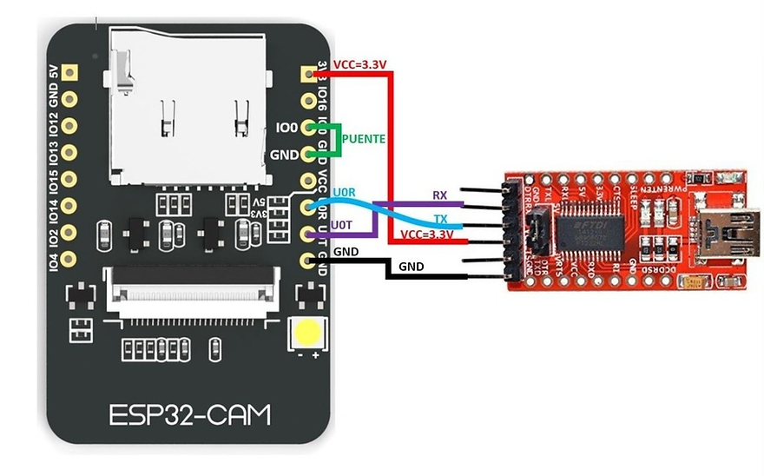
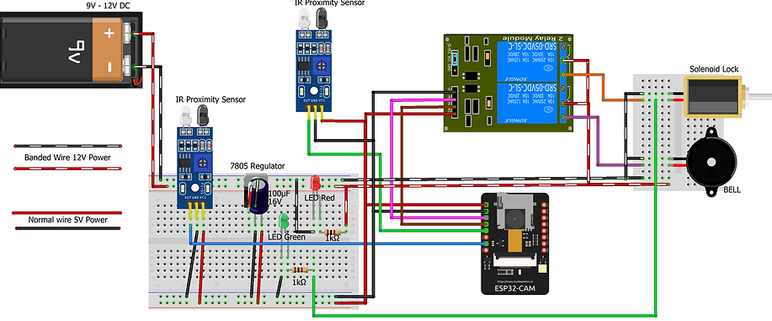
Circuit and Hardware Implementation:

Slide 20
Contribution of Team members
R E Dharshan(21113049)
Oversees the project, sets goals, and establishes timelines.
Allocates resources effectively and manages the budget.
Ensures the hardware is robust and cost-effective.
Designs the physical components of the doorbell system.
S S Harish Jayaram (21113050)
Develops the firmware for the doorbell system
Implements features like remote access, notifications, and user interfaces.
Ensures the software is user-friendly and compatible with various platforms.
Designs the user interface for the mobile app or web portal.
P A Abirajah (21113069)
Works on the product's physical appearance and aesthetics.
Takes ergonomics and ease of installation into consideration.
Identifies and reports bugs or issues for the software and hardware.
Ensures the product meets quality standards and safety regulations.

Slide 21
References
References:
Ms.Shefali Raina and Vishwesh Pratap Singh (2022): Contactless IoT Doorbell. 22nd Journal of Emerging Technologies and Innovative Research(JETIR),Volume 15, pp:6-17,
B.Baron Sam and A.Pio sajin (2022): Doorbell System in Home using IoT. International Conference on Frontiers in Materials and Smart System Technologies,Volume 34, pp:4,
Prof. S.B. Sahu and Kavita K. Tandi(2021): IoT & AI Based Smart Doorbell System. International Journal Of Creative Research Thoughts, Volume 13, pp:93
C.K Gomathy and Devulapalli (2021): A Study on IoT Smart Doorbells.
International Journal od Creative Research Thoughts, Volume 17, pp:200
Abhishek Gudipalli and Riddhi Gupta (2023): A smart doorbell solution for prevention of Covid-19. Journal of Behaviour Robotics
Nguyen and Chi-Ngon (2023): Design of a smart doorbell for a leader’s office with availability status notification and visitor recognition features. Journal of Innovation and Sustainable Development.
Satyam Kumar and Sajjan Singh (2021): Detection Smart Doorbell Based on IoT. Journal of Advanced Research in Medical Science & Technology Volume 8, Issue 4 - 2021, Pg. No. 7-10
Jaychand and Noman (2022): Smart Doorbell System based on Face Recognition. International Research Journal of Engineering and Technology (IRJET). Volume: 04 Issue: 03
Ms. Priyanka and Mr. Parveen Kantha(2020): Realization of an IoT System to Ensure Doorway Security by Integrating ESP32-CAM with Cloud Server. International Research Journal of Engineering and Technology (IRJET). Volume: 07 Issue: 10

Slide 22
THANK YOU

